Slide 1
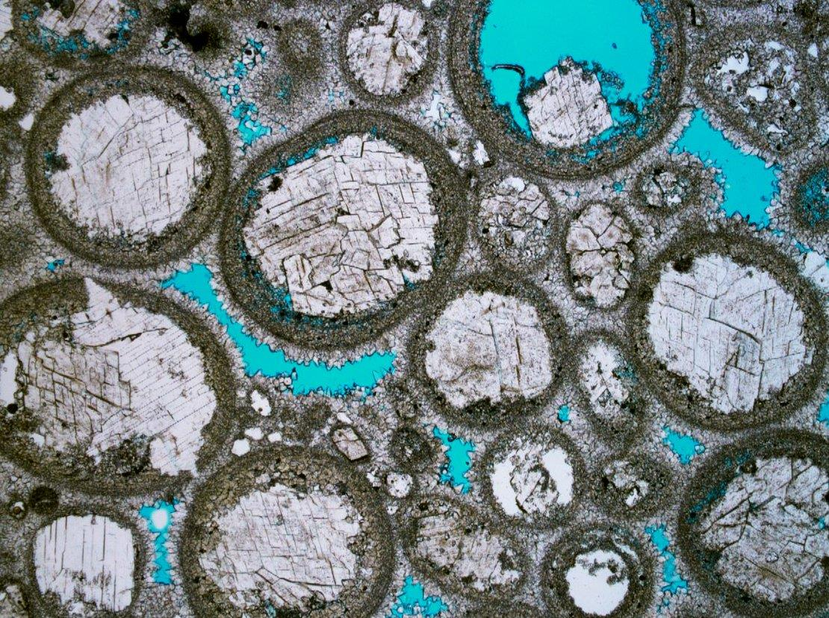
EART11100: Understanding the Earth
A dynamic planet
Diagenesis and Metamorphism.

Slide 2
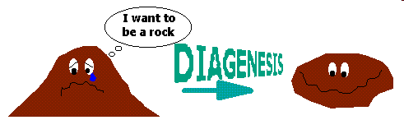
What’s the difference?
Diagenesis is A SERIES OF PROCESSES leading to the lithification (from greek “lithos”: rock) of loose sediment into rock.
Metamorphism is a change in the mineralogy and texture (shape and size of minerals) that occurs in the solid state (strictly no melting) following the application of thermal and mechanical energy,

Slide 3
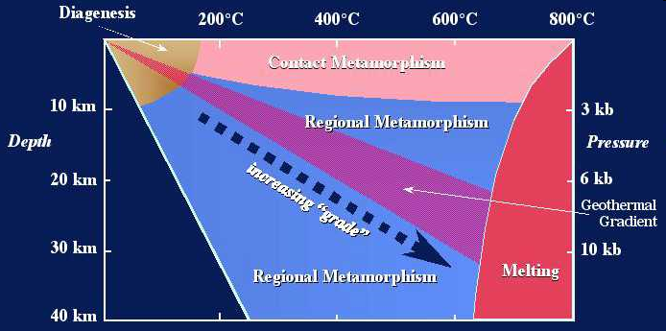
Both involve heating and addition of pressure.
Diagenesis is gradational into metamorphism, however:

Slide 4
What’s the difference?
Diagenesis is caused by simple burial by the addition of overburden in sedimentary basins.
Metamorphism is caused by the addition of heat or mechanical energy not possibly by simple addition of overburden by burial in basins.
Diagenesis can involve the addition of new materials (esp. cements), and a substantial change in the bulk composition of the rock.
Metamorphism is largely a closed system, with no change in the bulk composition of rock.
Sedimentary textures are still recognisable during and after diagenesis, but are not following metamorphism.

Slide 6
Summary of diagenesis
Compaction
  →Grain reorganisation/rotation

Slide 7
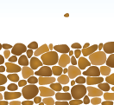
Compaction
Mechanical compaction by overburden causes grain reorganisation/rotation in order to reduce volume
  →rock volume is not reduced, but pore-space is reduced
  →grains are better “packed”
  →causes “dewatering” – expulsion of water that occupied the pore space.
Grains typically reorganise such that the long-axis moves to become perpendicular to compaction/shortening direction.
Expulsion of water.

Slide 8
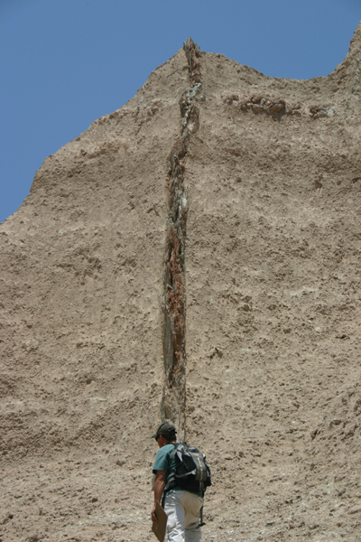
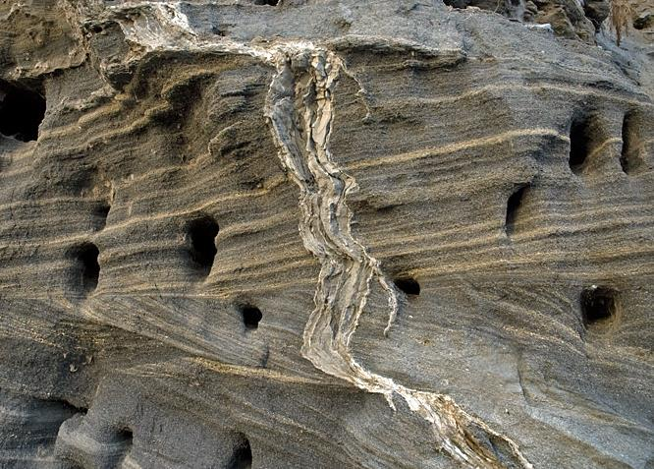
Compaction
Sandstone dykes, are evidence for dewatering during compaction.
  →sand grains are brought up with the water and injected through overlying sediment.

Slide 9
Summary of diagenesis
Compaction
  →Grain reorganisation/rotation
  →Grain fracturing

Slide 10
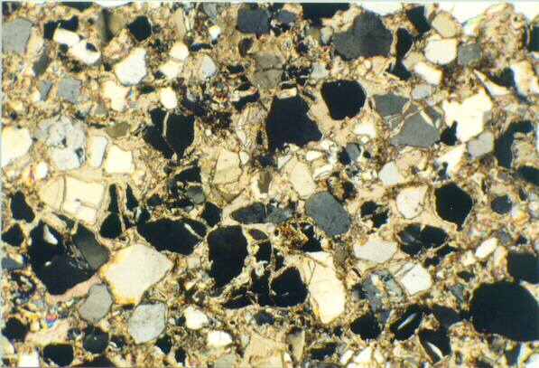
Compaction
Further compaction must be taken up by mechanical fracturing of grains
Abundant fractured grains in sandstone.
XPL thin section.

Slide 11
Summary of diagenesis
Compaction
  →Grain reorganisation/rotation
  →Grain fracturing
  →Pressure solution.

Slide 12
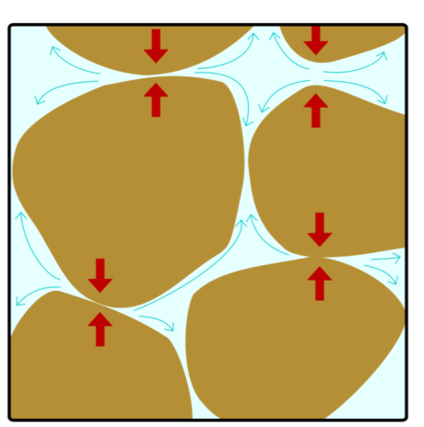
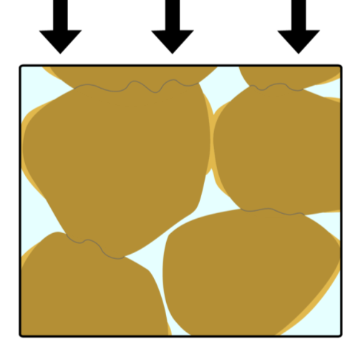
Compaction
Pressure solution is another manner in which compaction by overburden can reduce rock thickness.
  →Material at grain contacts perpendicular to compaction / shortening dissolve
  →The material re-precipitates as cement at grain contacts parallel to compaction / shortening.
  →Net result is also porosity loss.
Very common in carbonates for the ease at which those minerals will go into solution
Requires greater depths of burial for clastic sedimentary rocks.

Slide 13
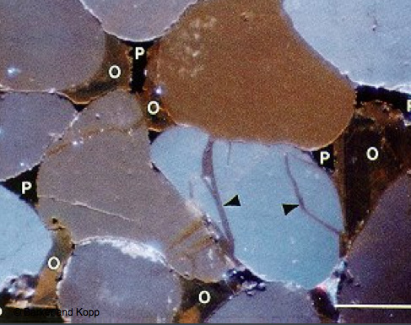
Compaction
XPL thin section image of pressure solution surfaces, and locally derived cement.
Note flat, or indented (concave) grain contact perpendicular to compaction, and natural (convex) surfaces parallel to compaction, with cements

Slide 14
Summary of diagenesis
Compaction
  →Grain reorganisation/rotation
  →Grain fracturing
  →Pressure solution
Dissolution

Slide 15
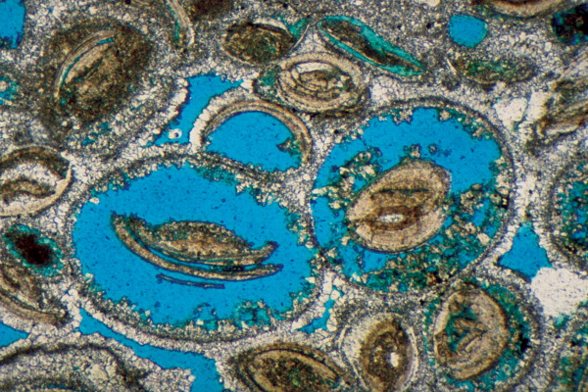
Dissolution
Dissolution is caused by changes in T and P, and or the composition of pore-water, which results in the mineral being more stable in solution
  →For example, pumping fresh (“meteoric”) water through many carbonates results in dissolution of calcite and aragonite: this can happen close to the surface
  →But quartz will go into solution with greater difficulty (needs greater burial depth).
Dissolution without reprecipitation occurs in systems which are subjected to prolonged pumping of exotic pore-water, with an abundant fresh supply
  →Inhibits the saturation of the pore waters and re-precipitation of minerals
  →Common in carbonates, less common in clastic sedimentary rocks

Slide 16
Summary of diagenesis
Compaction
  →Grain reorganisation/rotation
  →Grain fracturing
  →Pressure solution
Dissolution
Cementation

Slide 17
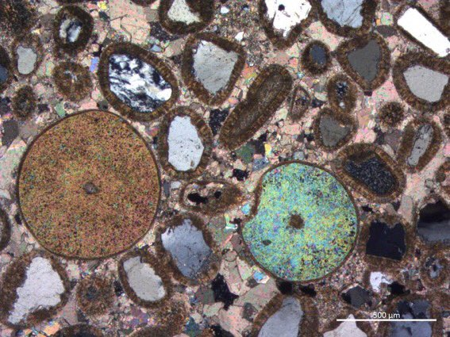
Cementation
Cementation is the process by which chemical precipitates (new crystals) form in the pores of a sediment or rock and bind the grains together.
Common cements are quartz, and various carbonates (calcite, aragonite, dolomite), and clays.
Cementation reduces primary porosity by filling in the pore spaces between the grains.

Slide 18
Summary of diagenesis
Compaction
  →Grain reorganisation/rotation
  →Grain fracturing
  →Pressure solution
Dissolution
Cementation
Recrystalisation

Slide 19
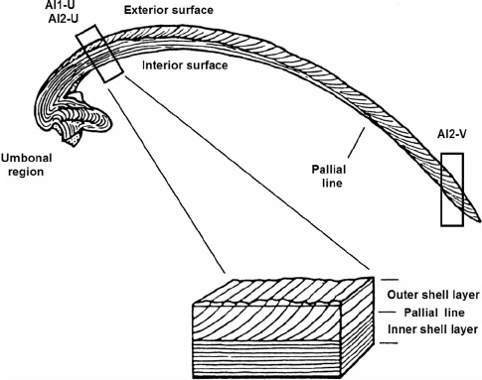
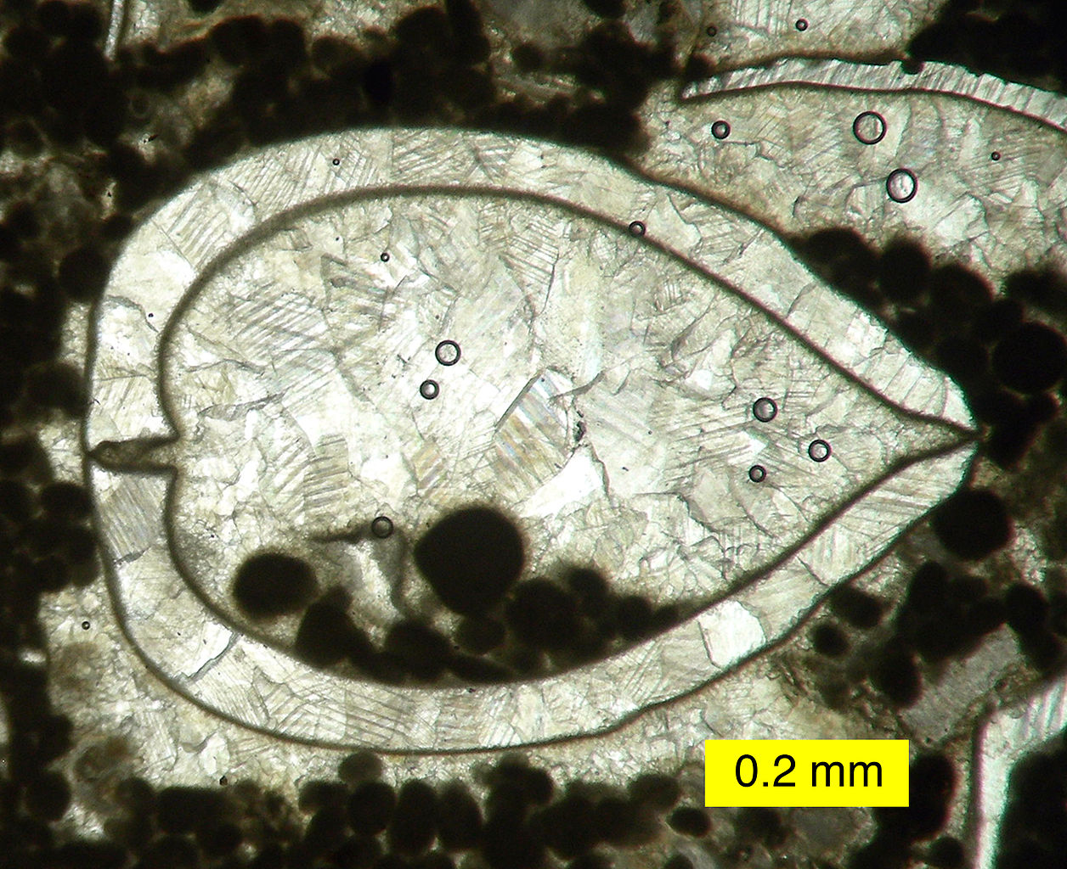
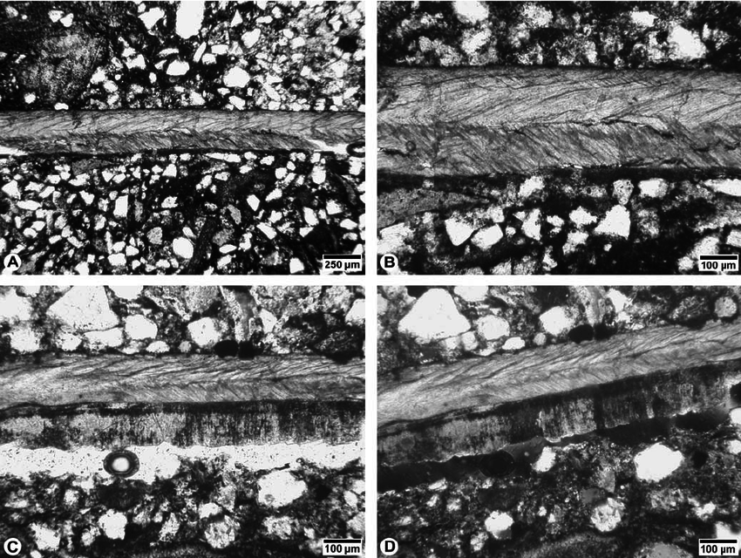
Recrystallisation
Recrystallisation refers to the reorientation of the same crystal lattices in mineral grains
  →it occurs as a result of solution and reprecipitation of the same mineral phase already present.
  →does not usually involve net pore space change

Slide 20
Summary of diagenesis
Compaction
  →Grain reorganisation/rotation
  →Grain fracturing
  →Pressure solution
Dissolution
Cementation
Recrystalisation
Mineral Replacement.

Slide 21
Mineral replacement
Mineral replacement occurs when a newly formed mineral replaces a preexisting one in situ.
→the new grain may have the same composition, but is a polymorph of it (e.g. replacement of biogenic Aragonite with Calcite)
  →complete replacement on a mineral phase with another (e.g. Calcite to Dolomite)
Changes in polymorph or ion exchange leading to the formation of new minerals, can lead to changes in volume, which can destroy or increase porosity
  →E.g. transformation of calcite to dolomite leads to an 11% decrease in mineral volume (and equal increase in pore space)

Slide 22
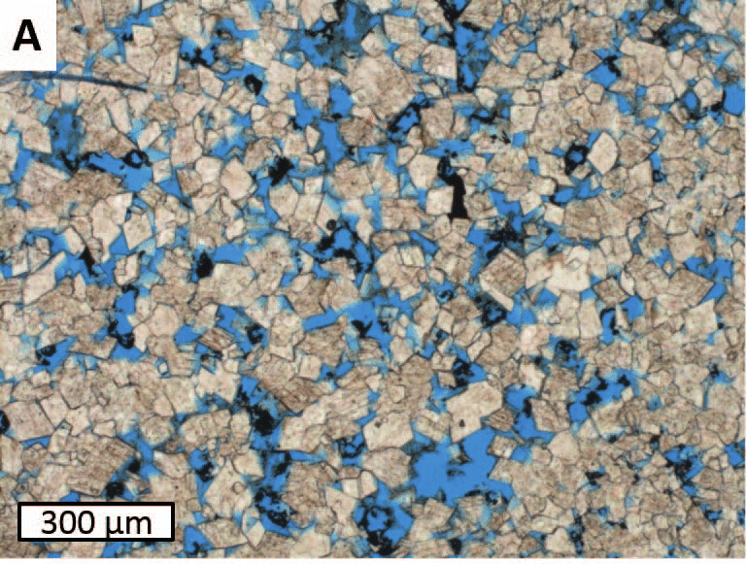
Mineral replacement
2 CaCO_{3(calcite)} + Mg²⁺ ↔ CaMg(CO₃)_{2(dolomite)} + Ca²⁺
(No need to lean)
Dolomitisation is an example of mineral replacement, which has garnered a lot of interest, because this diagenetic processes increases porosity (blue), which is good for hydrocarbon or water subsurface storage

Slide 23
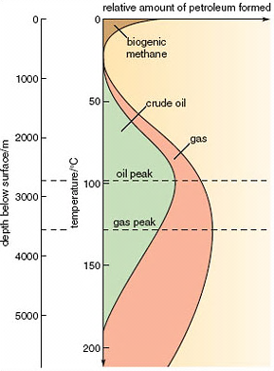
Effects of diagenesis
Maturation in basin with geothermal gradient of about 35 ºC/km
Mature source rocks can generate petroleum
Oil/gas windows – temperature ranges for oil/gas generation
Oil peak: temperature of max oil generation
Gas peak: temperature of max gas generation
Overmature source rocks do not generate oil or gas anymore

